Slide 1


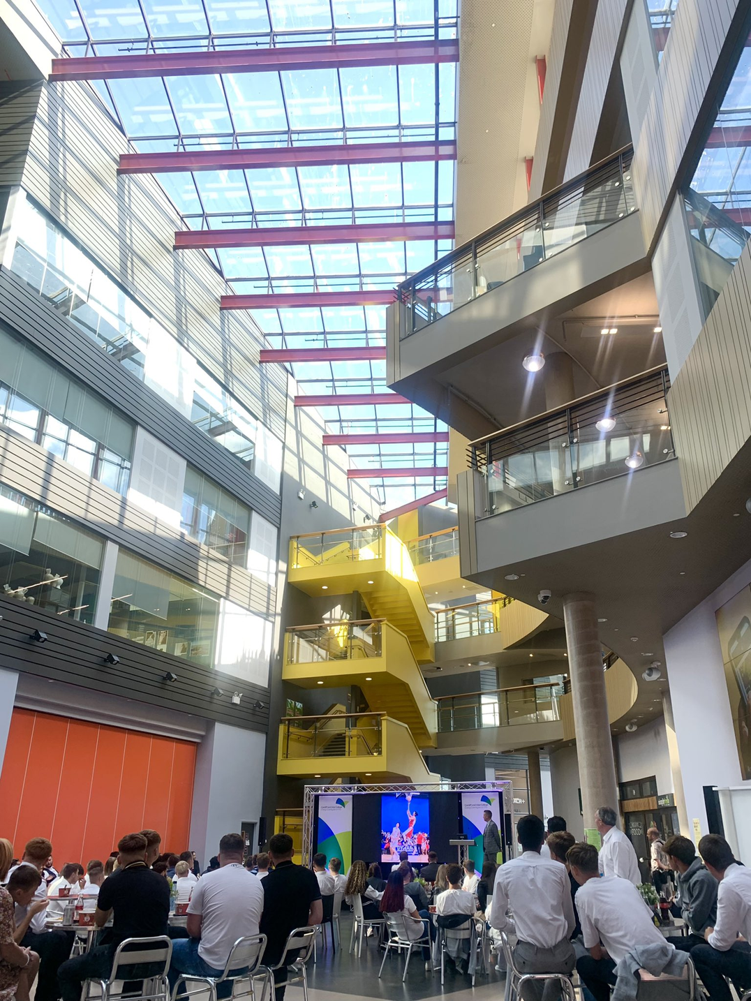

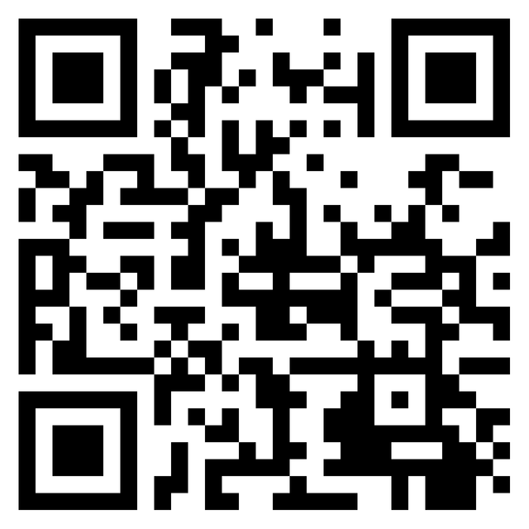


Scavenger Hunt
Thank you for joining us on the next step in your journey.
It’s time to welcome you to CAVC
To start the Scavenger Hunt
Head to the place of coffee and tea!

Slide 2
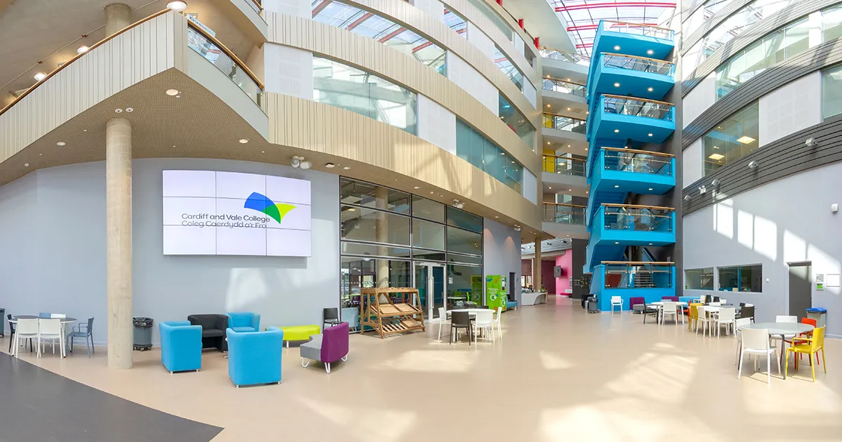
GENERAL EDUCATION
The plan:
1
Getting used to the building
Follow the instructions to locate key areas of the college you need to become familiar with.
2
Get a bit lost
Make sure you use the different routes to places, keep your eyes open for which floor you're on,
3
Scan the QR code at each clue
You will be asked to complete a task and add an image to the padlet for each stop to prove you have been there!
Top tip!
There will be an image on the padlet for you
to find the next place
COME BACK HOME
4
This room is your home for this session - ultimately find your way back here after you have been to the final stop to claim your prize!

Slide 3


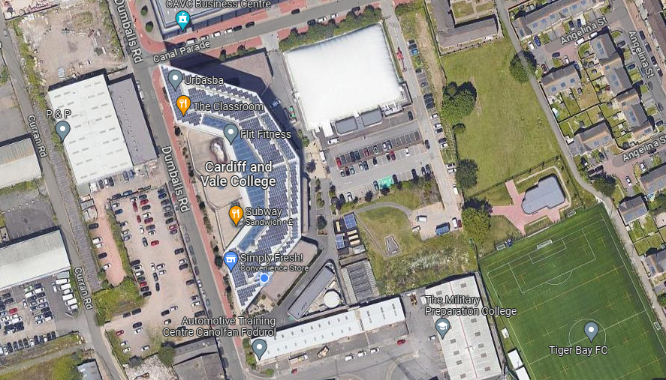
GEGENERAL EDUCATION
Weclome home
HOW DID IT GO?
Anything too difficult to find?
Have you learned any shortcuts? Tips for finding places?
Any questions?

